Slide 1
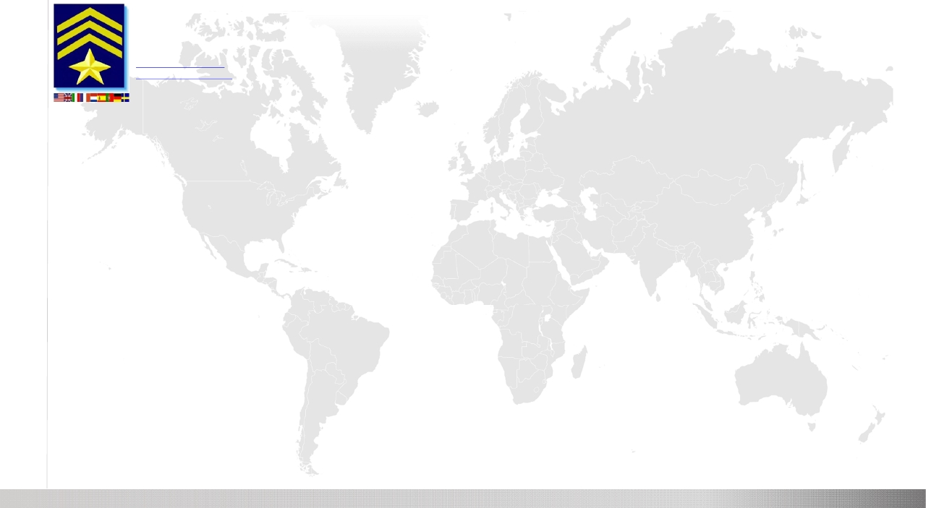
SAR Technology Inc.
5268 Sprucefeild Road West Vancouver
B.C., Canada, V7W 2X6
http://sartechnology.ca
sartechnology@telus.net
Phone: 604 921-2488
Fax: 604 921-2484
INCIDENT COMMANDER PRO' V8

Slide 2
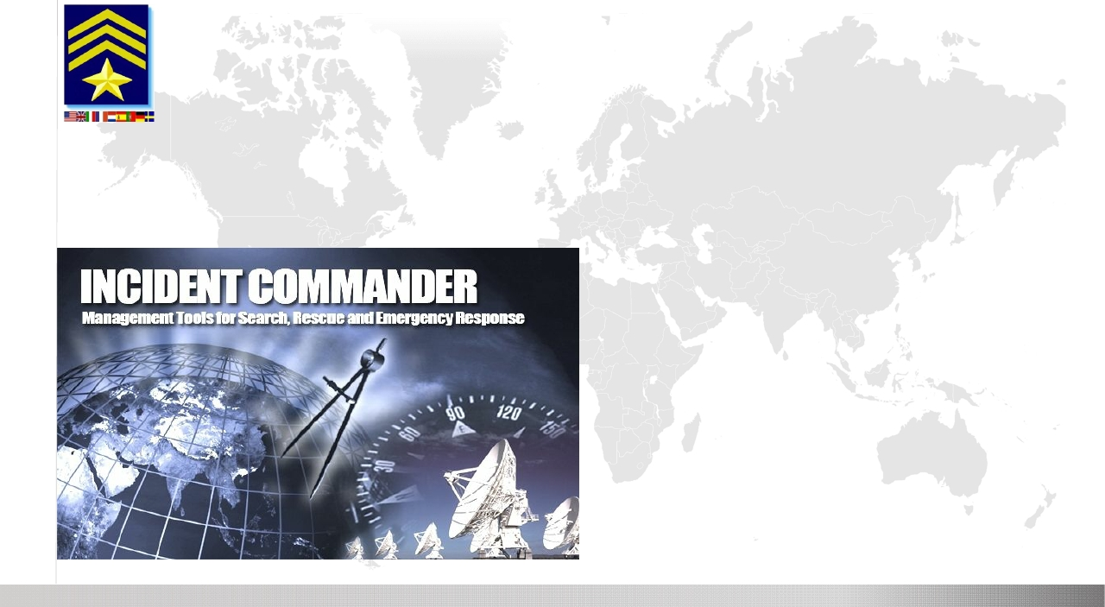
PREMIER SOFTWARE FOR
SEARCH | RESCUE | SAFETY
SECURITY | EMERGENCY RESPONSE
GIS Mapping | Mobile Tracking | GPS Plotting | Message Alerts
Global Earth Tools | Smartphone Tracking | GPS Radio Tracking
Coverage POD Calculator | Data Import Export | Expanded Database
▪
▪
▪
▪
▪
▪
▪
▪
▪
▪
▪
▪
Manage Search, Rescue & Emergency missions!
Plan and Protect People and Infrastructure.
Real-time Satellite Tracking of People & Equipment.
Local and Remote Messaging, including SOS/Help.
Monitor Responder Safety: Tracking & Messages.
Real-Time 'Live' Mission Maps & Status Displays.
Seamlessly Manage People, Information & Resources.
Create Response Plans for Immediate Activation.
Integrated Planning Information, Data & Images.
Enhanced Network-Capability for Multi-Users.
Extensive Reporting, Importing and Exporting.
Familiar NIMS / Incident Command structure.
SAR Technology Inc

Slide 3
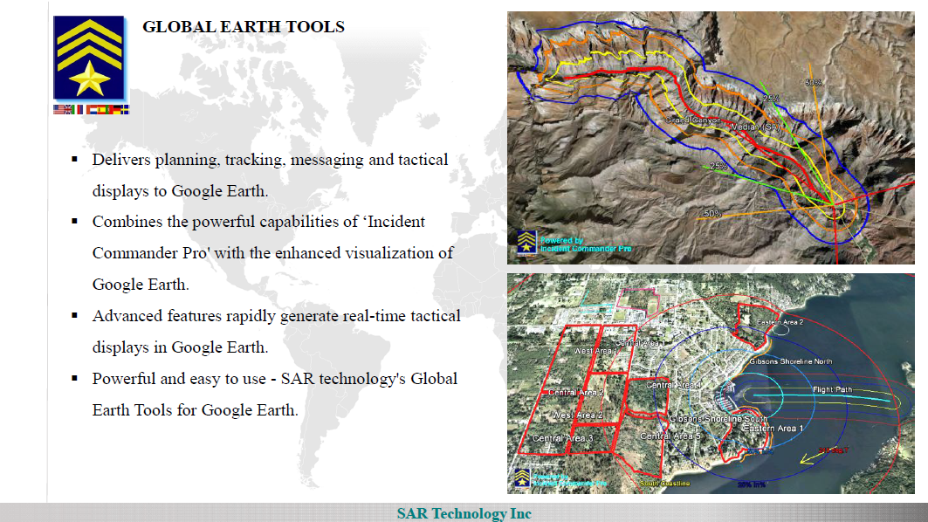

Slide 4
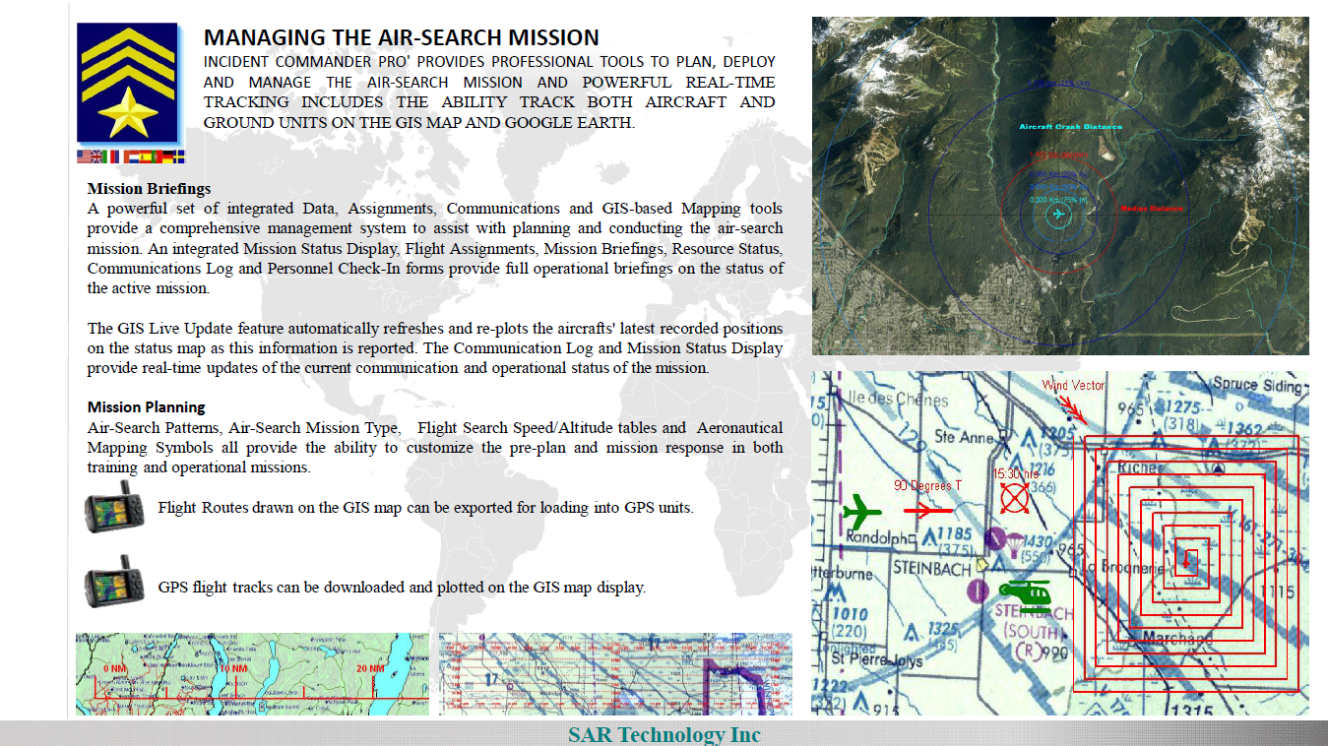

Slide 5
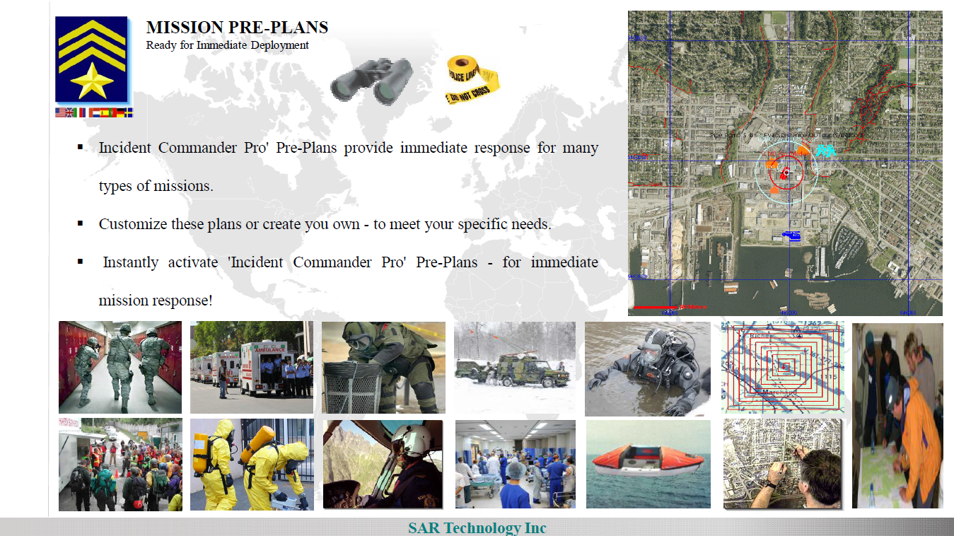

Slide 6
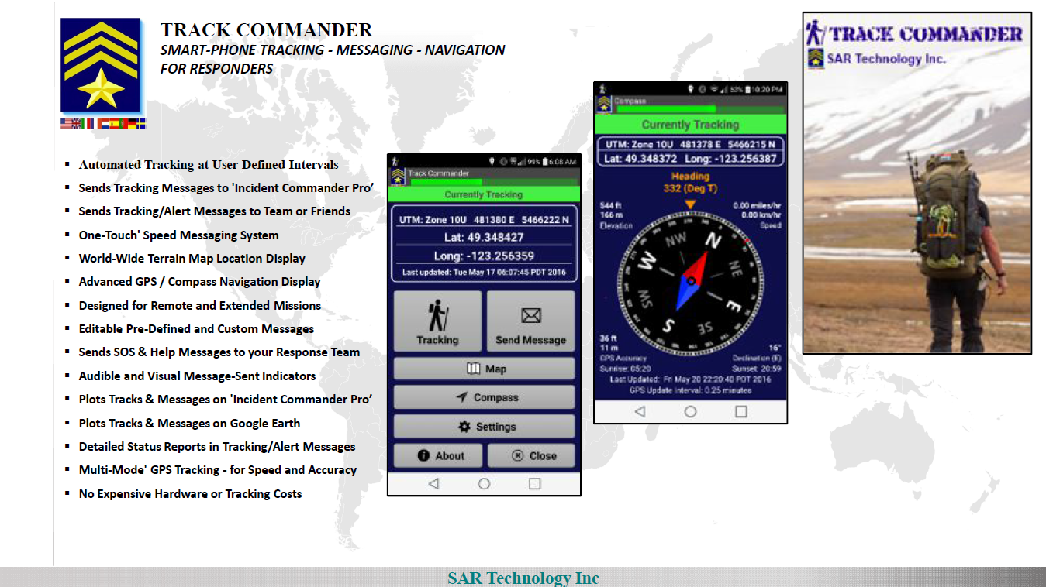

Slide 7
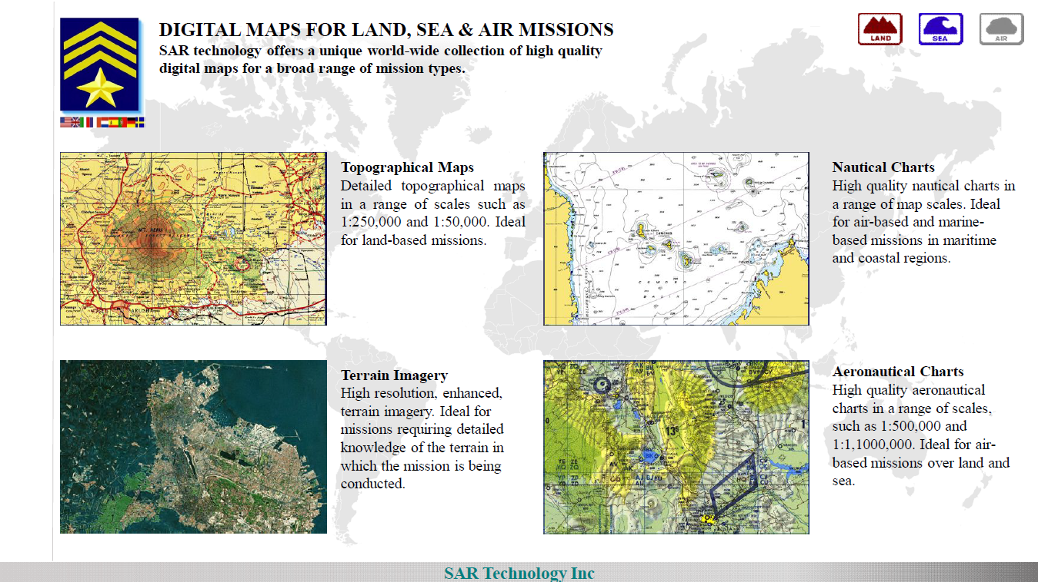

Slide 8
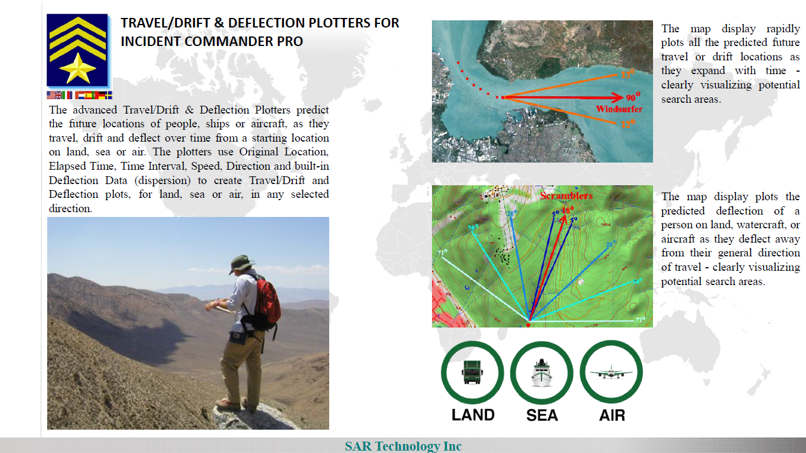

Slide 9
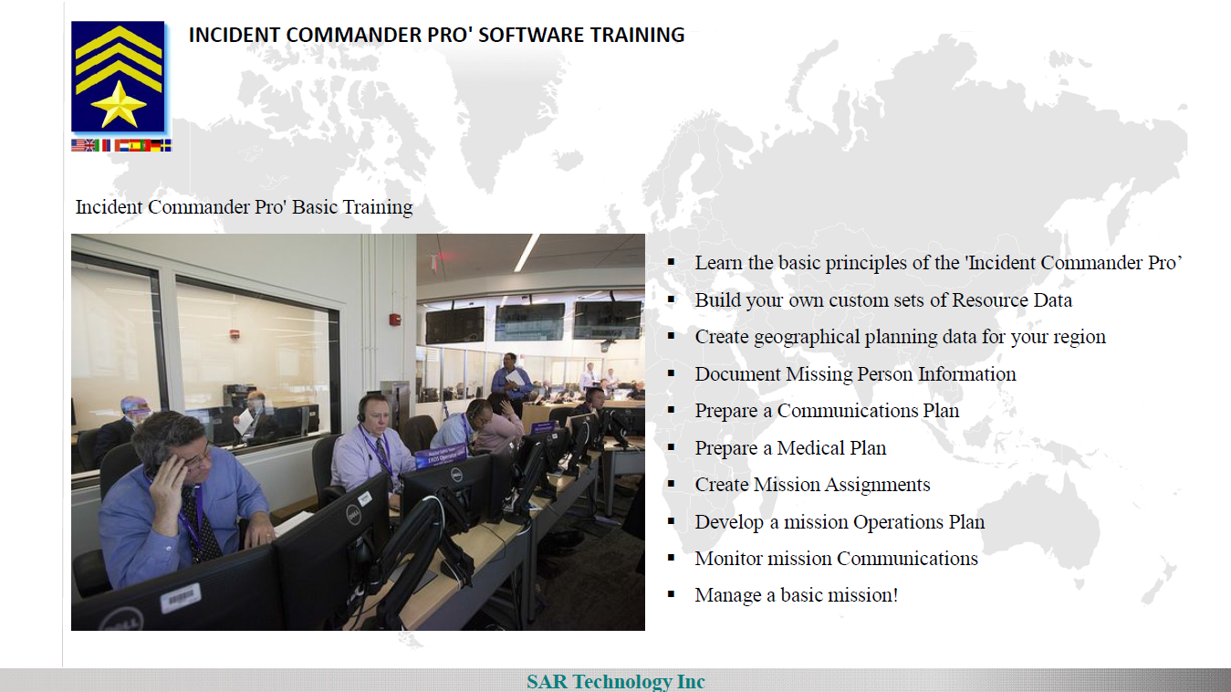

Slide 10
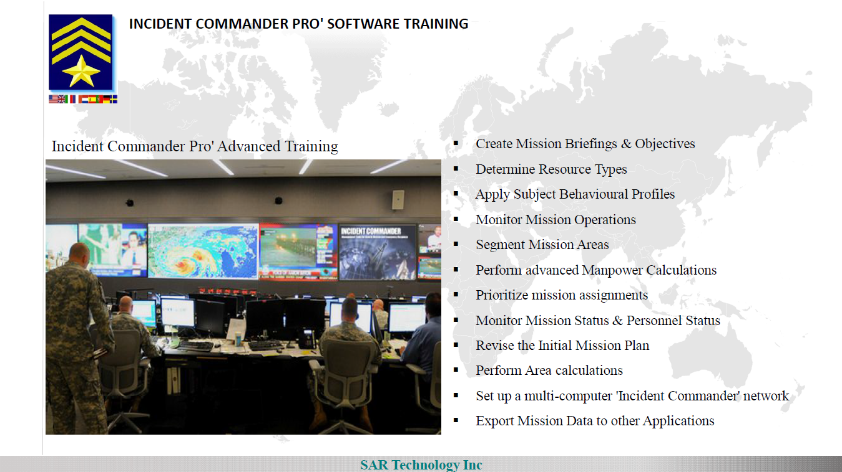

Slide 11
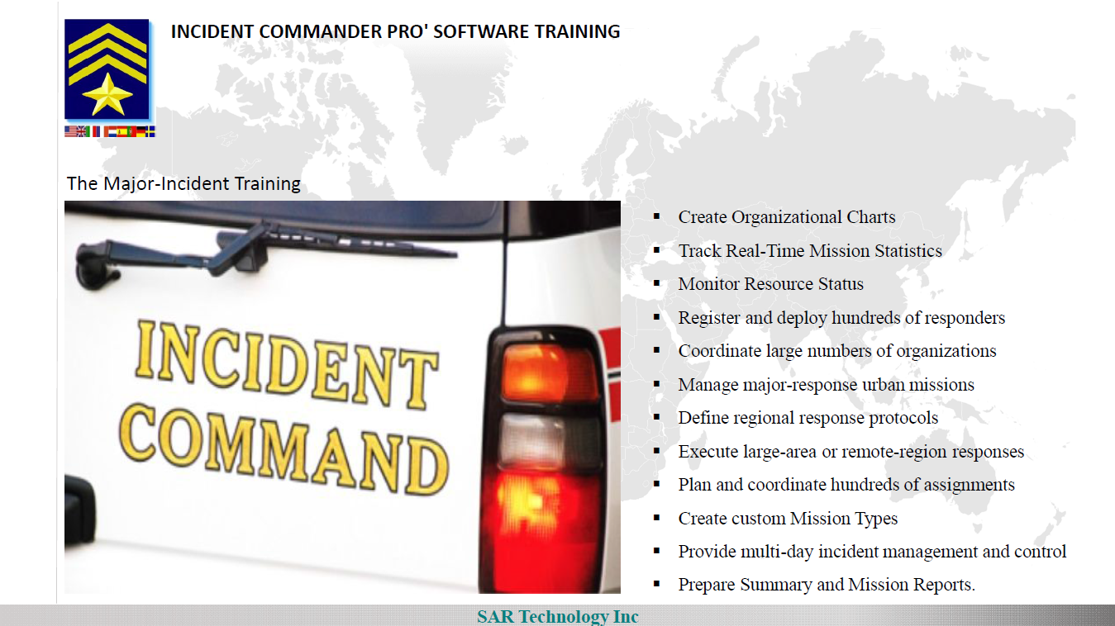

Slide 12
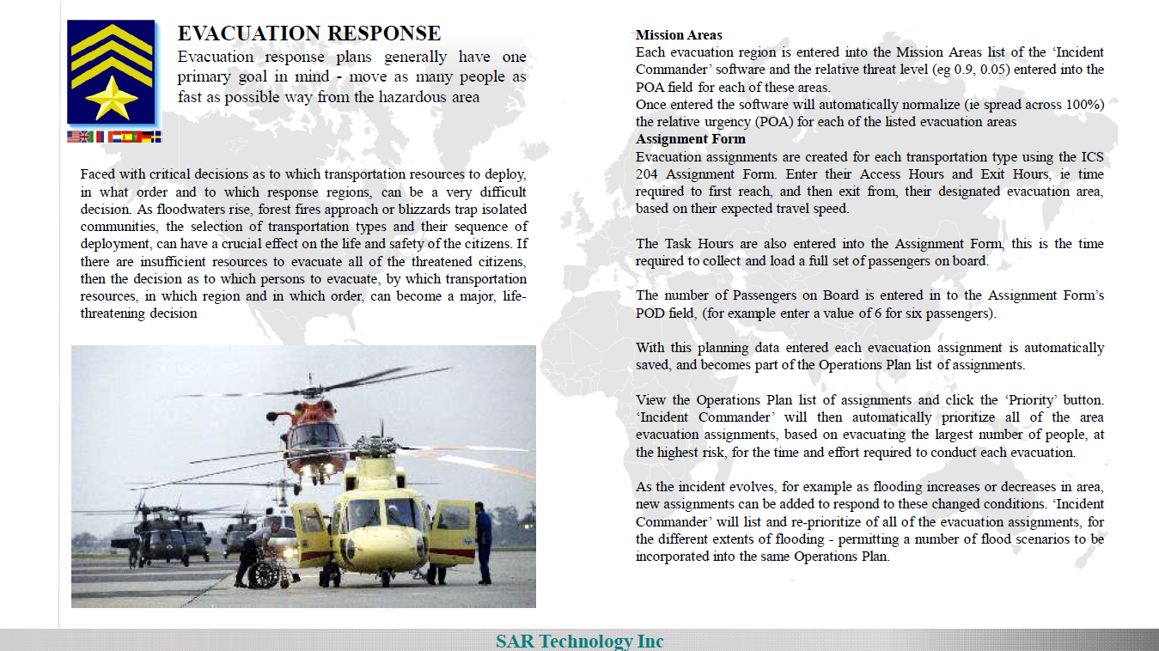

Slide 13
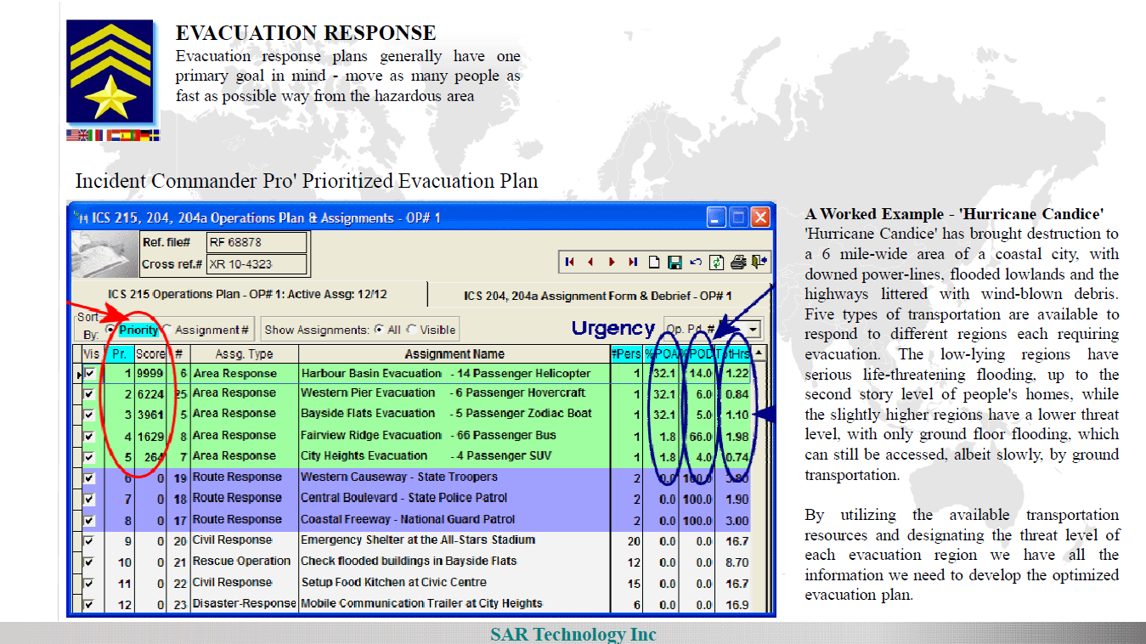

Slide 14
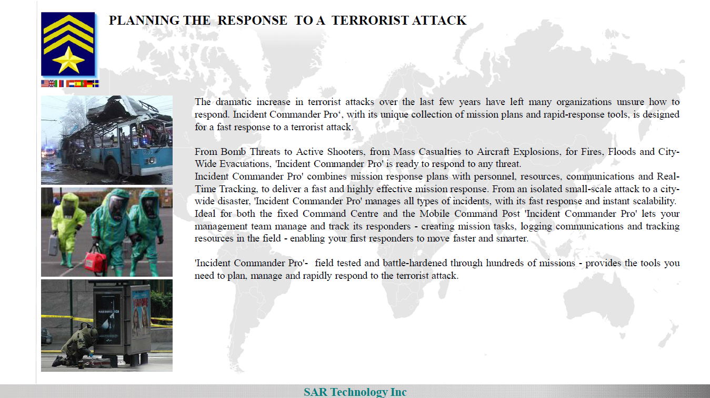

Slide 15
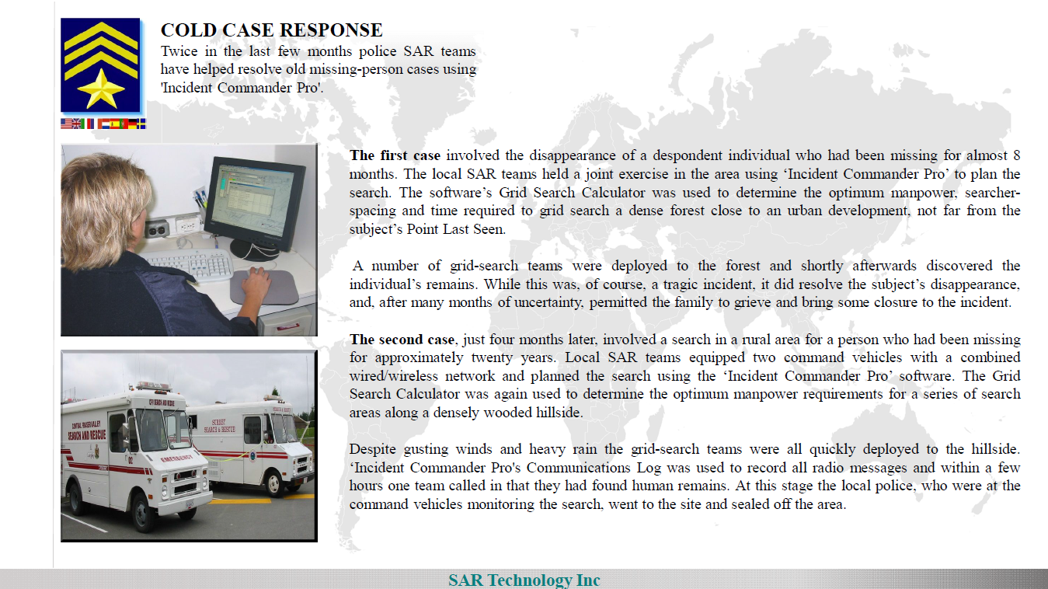

Slide 16
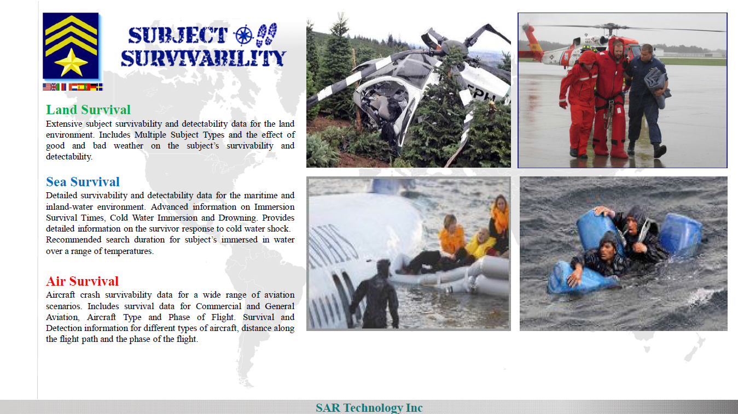

Slide 17
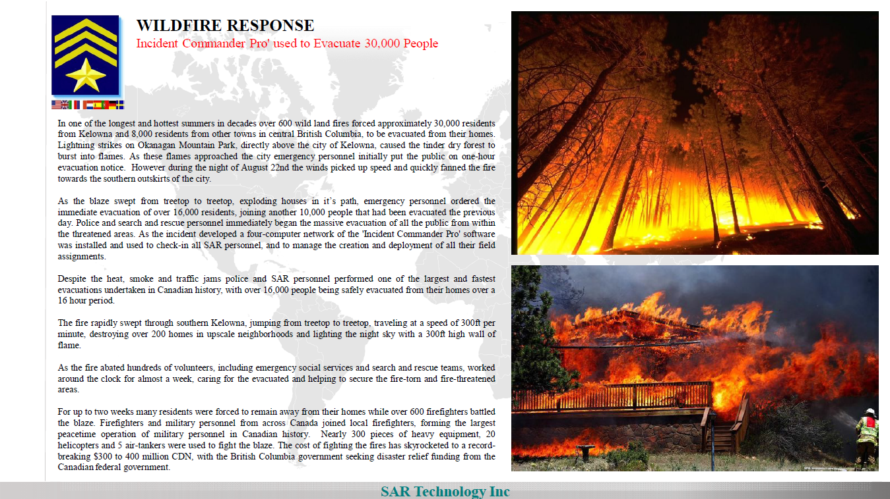

Slide 18
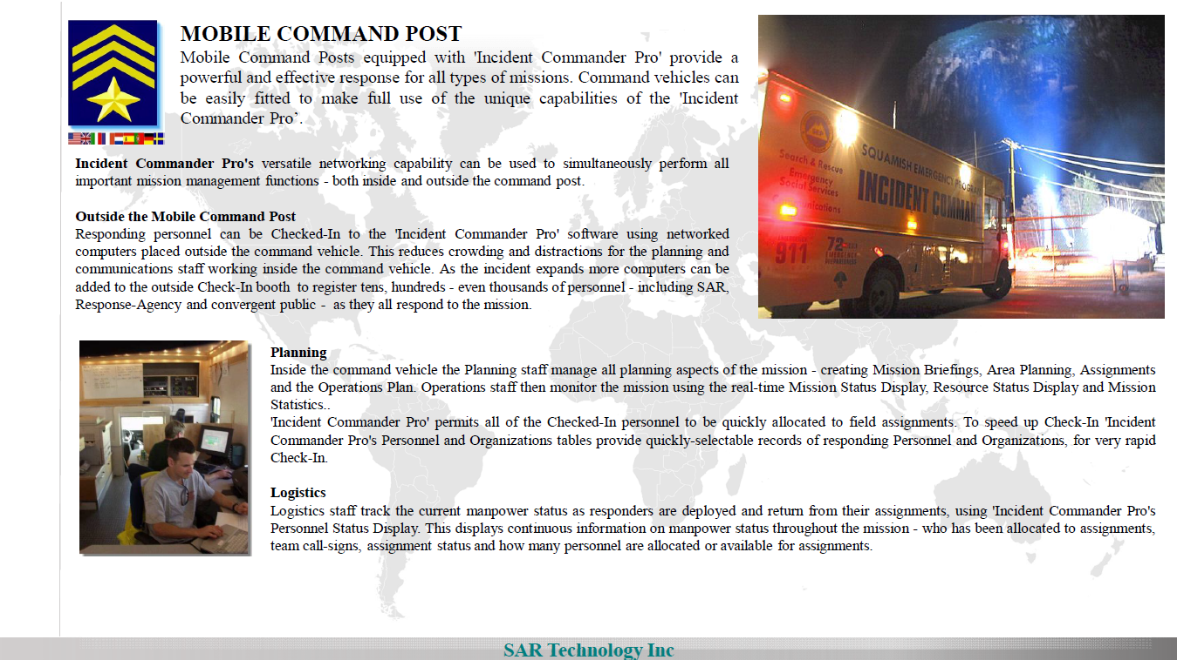

Slide 19
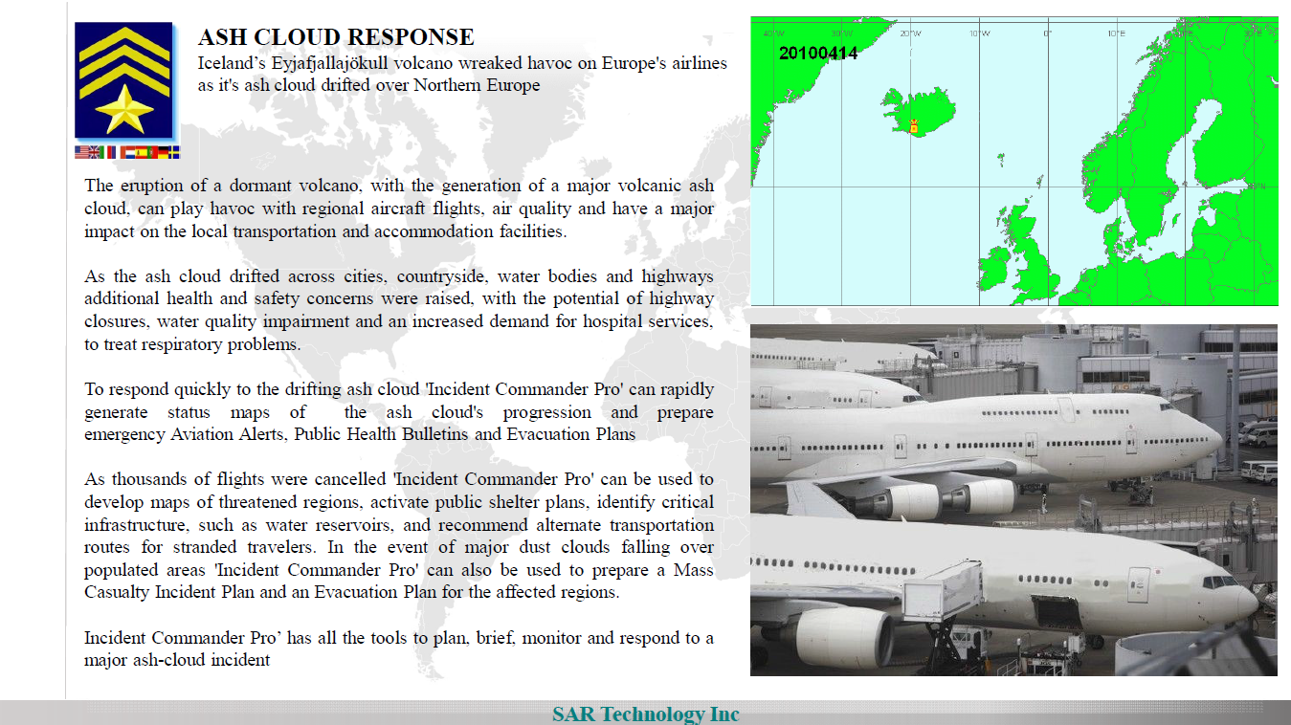

Slide 20
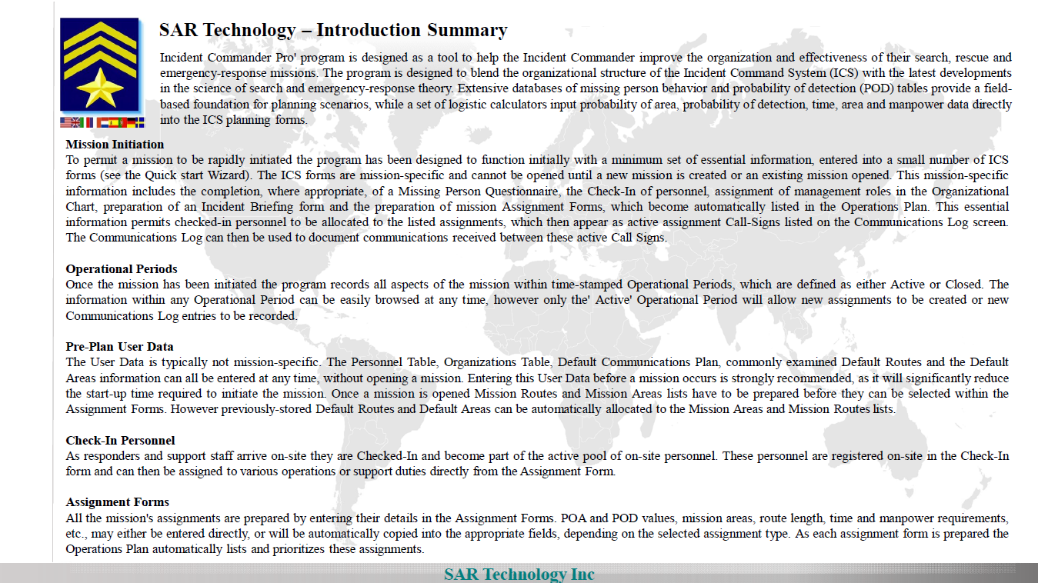

Slide 21
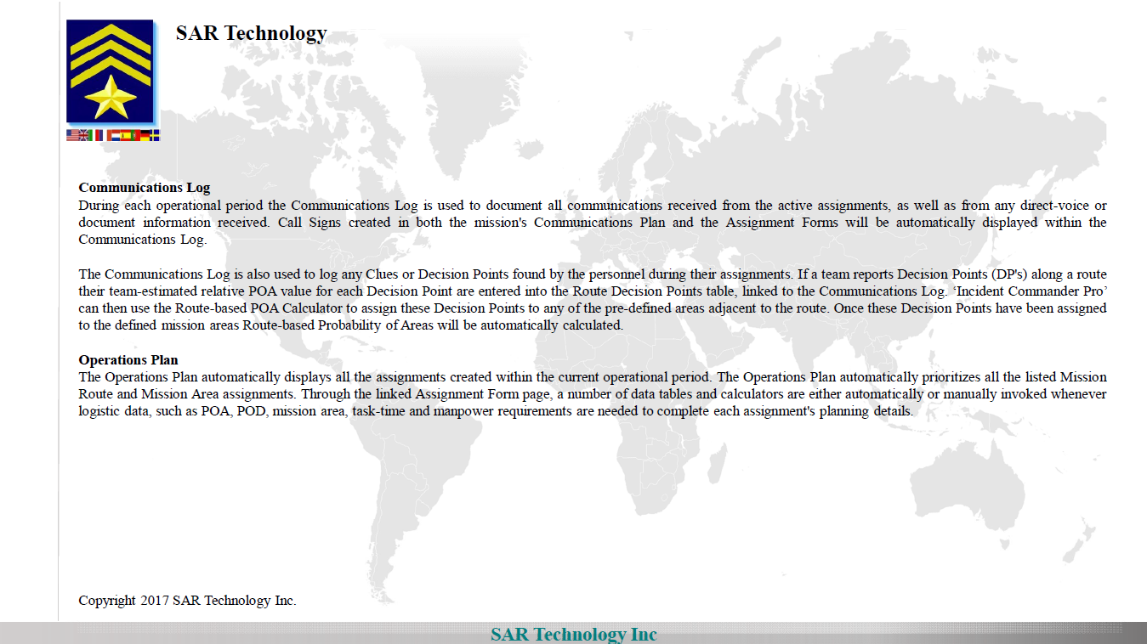

Slide 22
