Slide 1



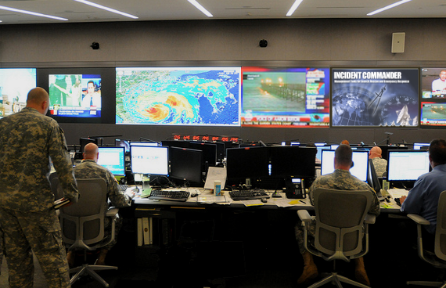
’Incident Commander Pro’
- SAR Mission Response

Slide 2





’Incident Commander Pro’
Typical Command Center Layout
Incident
Commander
Mapping
Command
SAR Server
Operations
Data
Planning
Calculations
Logistics

Slide 3


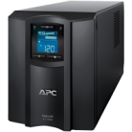
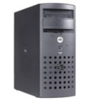
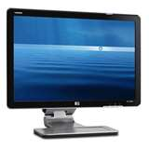

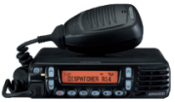





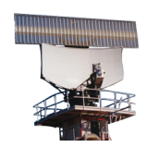



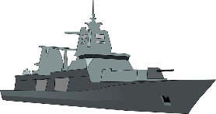
’Incident Commander Pro’
Typical Command Center Infrastructure
Incident
Commander (IC)
Command /
Deputy IC
Logistics /
Communications
Operations
Planning
Mapping
6- 8 Staff Members
SAR Server, UPS, Computers, Displays, Printers
VHF/UHF Radio System
Phone, Internet & Email
Data Feeds – Met/Civil/Defence Radar, Distress Beacons, SAR Rescue Craft

Slide 4


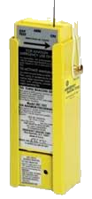
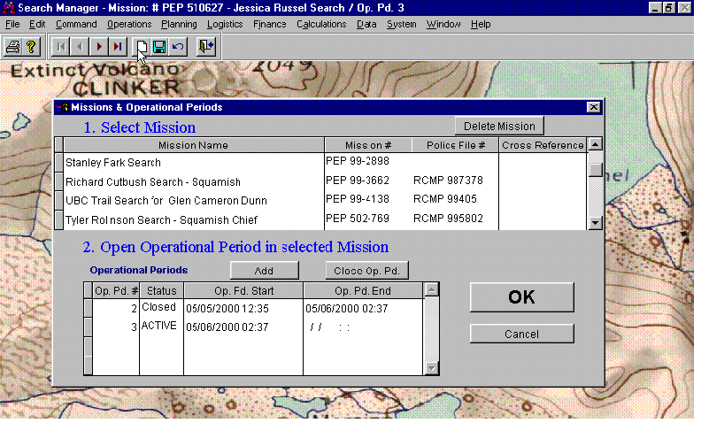

’Incident Commander Pro’
A distress call comes in…
- Open a New Mission

Slide 5
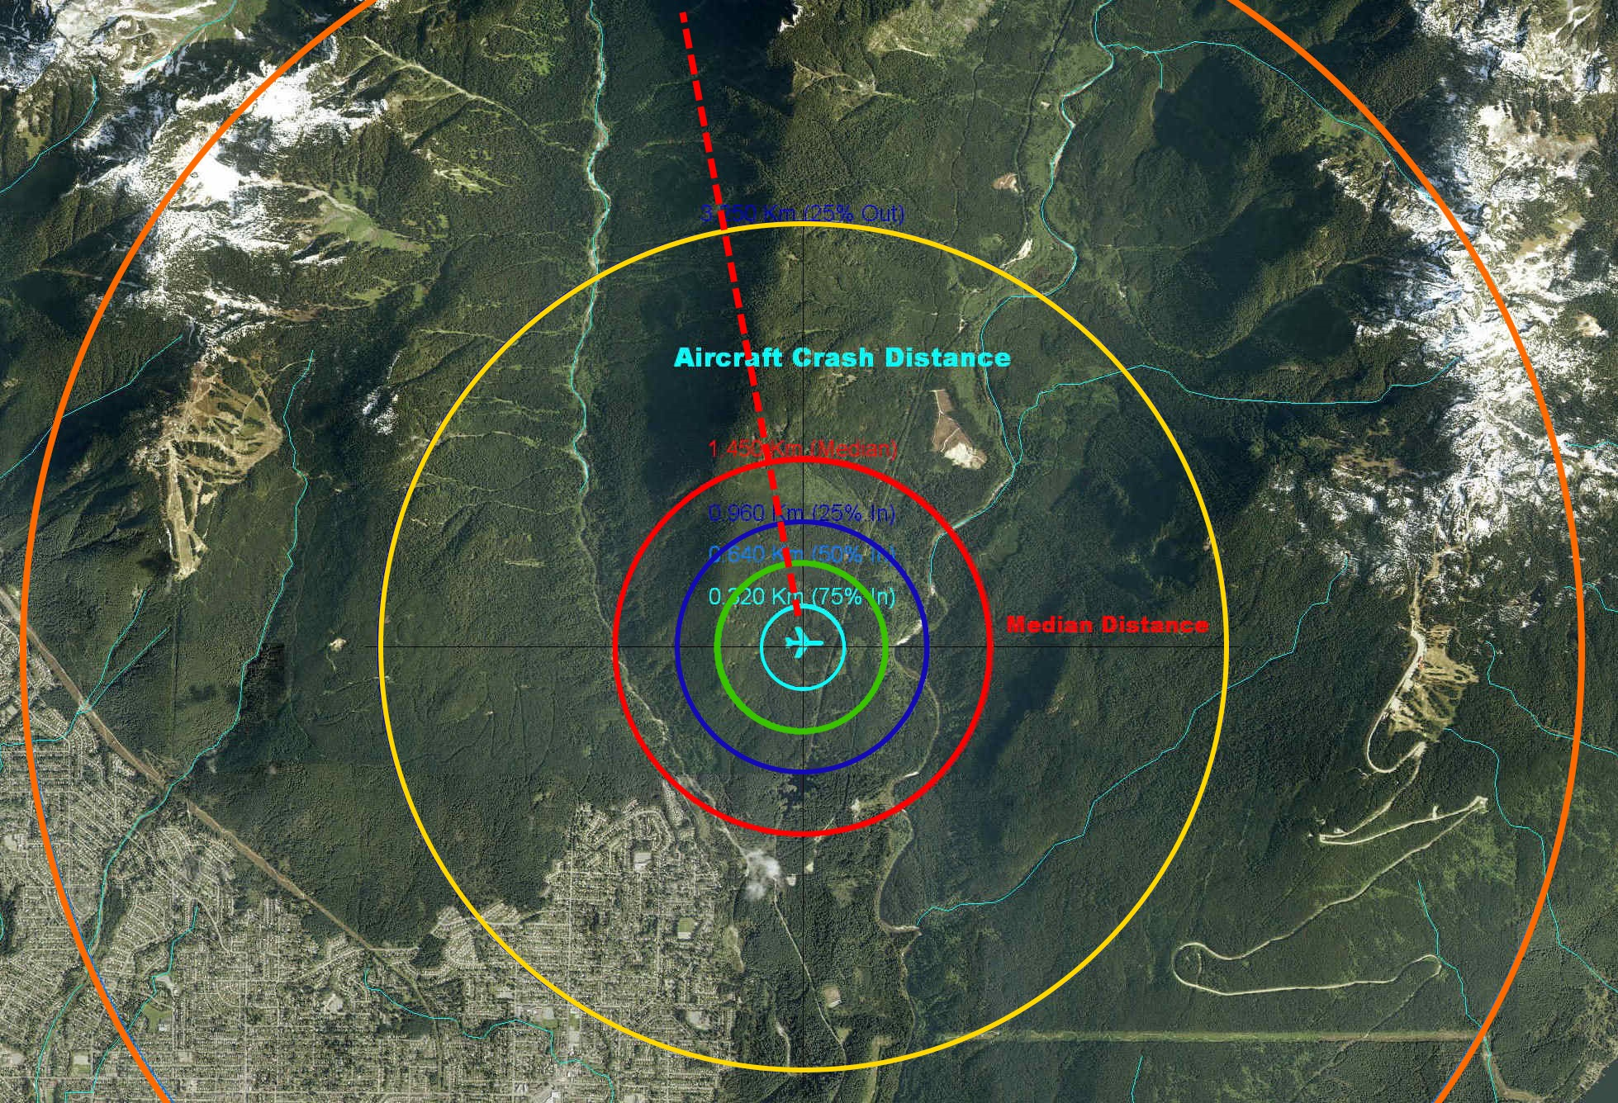
’Incident Commander Pro’
- Determine the Search Location…

Slide 6



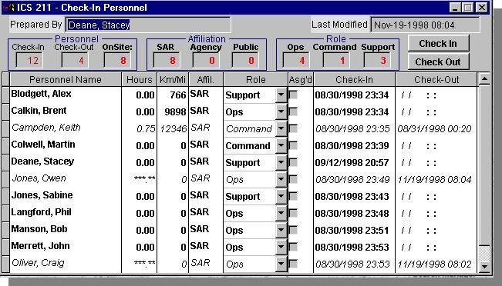
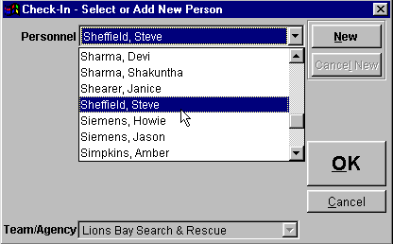
’Incident Commander Pro’
- Check-In
Response Personnel…

Slide 7
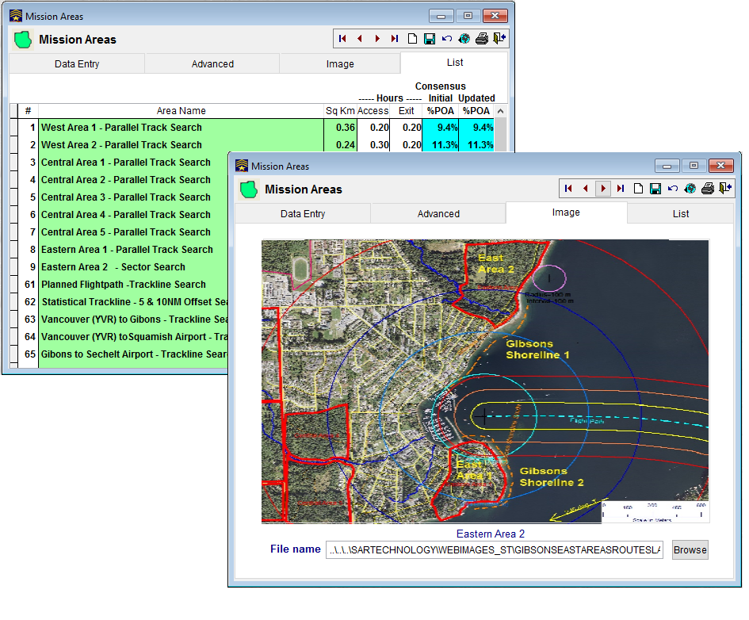

’Incident Commander Pro’
- Define the Mission Search Areas…

Slide 8
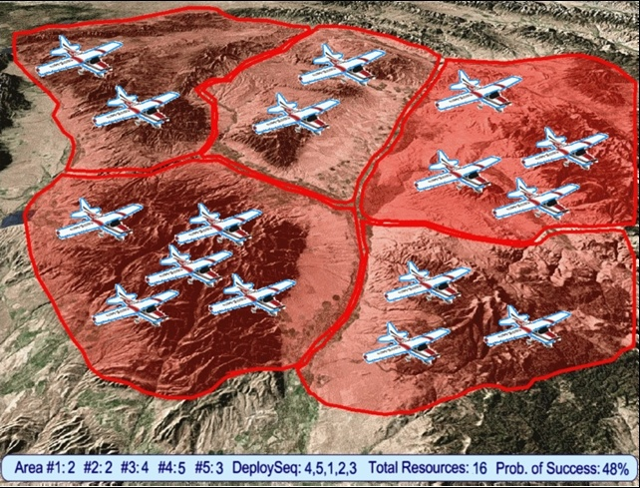
’Incident Commander Pro’
- Allocate Search Resources to the Mission Areas Areas…

Slide 9

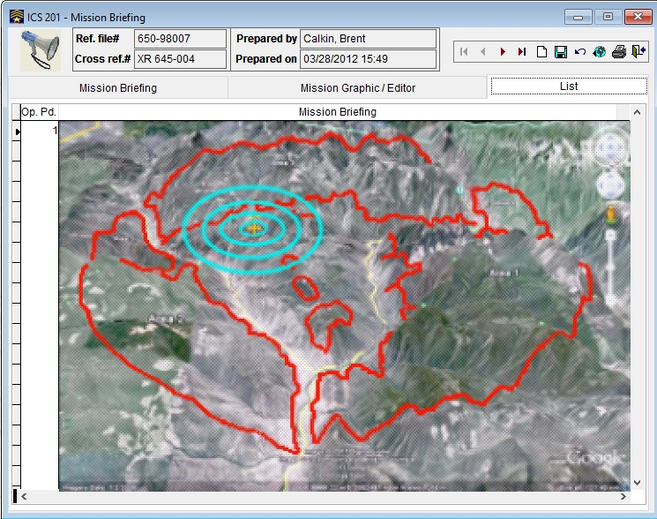
’Incident Commander Pro’
- Brief the Search Responders…

Slide 10
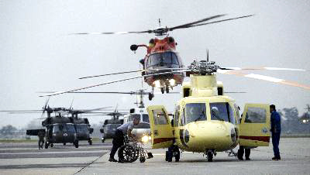
’Incident Commander Pro’
- Deploy the Search Resources…

Slide 11

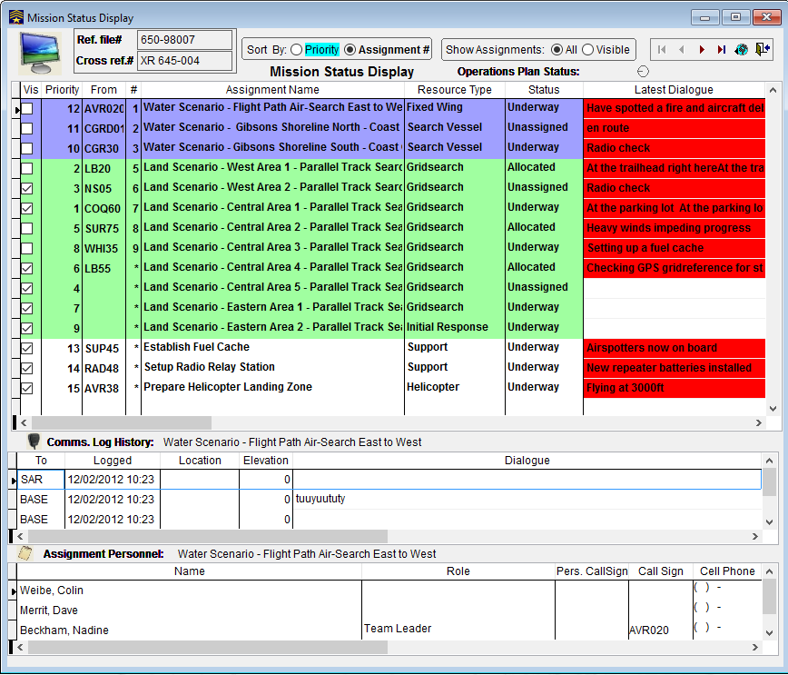
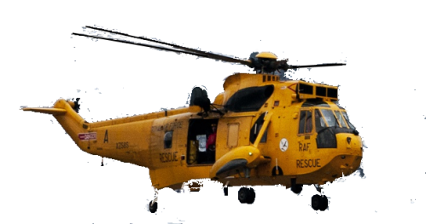



’Incident Commander Pro’
- Monitor the Search Progress…

Slide 12

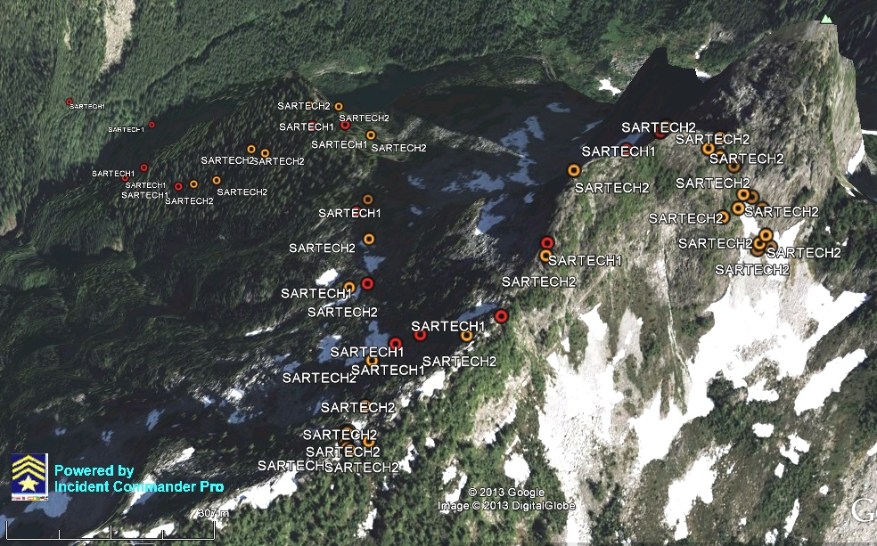
’Incident Commander Pro’
- Track Resource Locations…

Slide 13
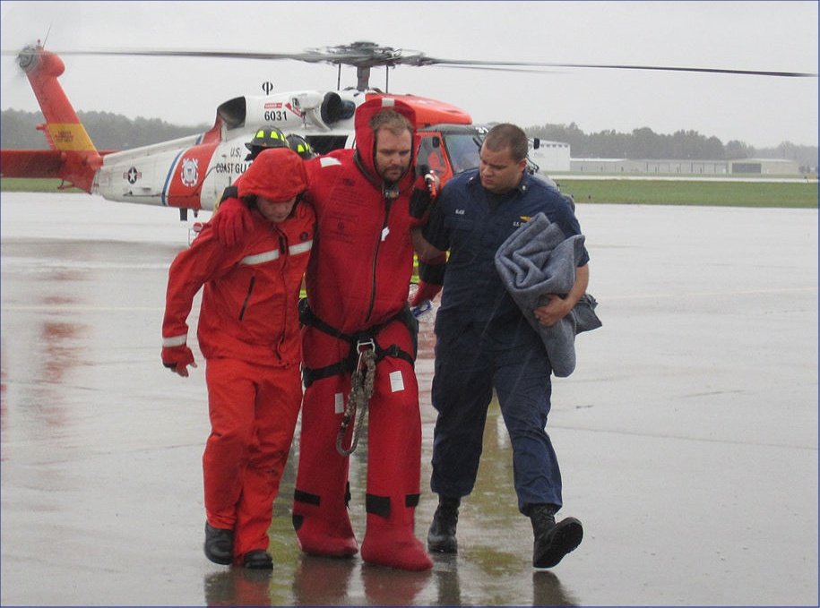
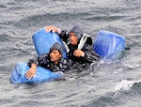
’Incident Commander Pro’
- Rescue Survivors…

Slide 14




SAR Technology Inc.
5268 Sprucefeild Road West Vancouver
B.C., Canada, V7W 2X6
http://sartechnology.ca
sartechnology@telus.net
Phone: 604 921-2488
Fax: 604 921-2484
’Incident Commander Pro’
FAST, EFFICIENT & EFFECTIVE
- TO SAVE LIVES
SAR Technology Inc

